Slide 1
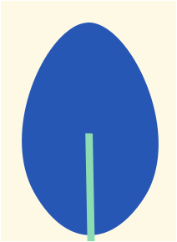
SustainaBites
Corinne Loth, Ann Teoh, Callum Wilson, Serena Theophile

Slide 2
Why SustainaBites?
In order to save our planet, everyone must gain more responsibility within our environment
Some people do not realize that certain foods impact the environment in different ways
With our app, you can keep track of your environmental impact because it is able to tell you which foods are better or worse for the environment
It can up the awareness of what you’re buying, thus leading you to make better decisions for our planet
Notes:
Serena

Slide 3
Observation
Reviewed frequency of purchase + consumption of different food groups among 8 students
I.e., meat, seafood, dairy products, fruits and vegetables
Conducted interviews as well
Perceived tie between sustainability + food habits
“I just buy what I want to eat and drink, the environment feels kind of irrelevant to those daily decisions”
“I try to balance things out and not eat too much meat, but I don’t really know the impact honestly”
Notes:
Corinne

Slide 4
User Need
UW students and grocers need a way to stay aware of personal diet/food choices and the impact of these choices on the environment. Resources are also needed to be informed about how food sourcing contributes to sustainability.
POV: I want to help the environment through my food intake, but does it have to be so confusing?
Notes:
Corinne

Slide 5
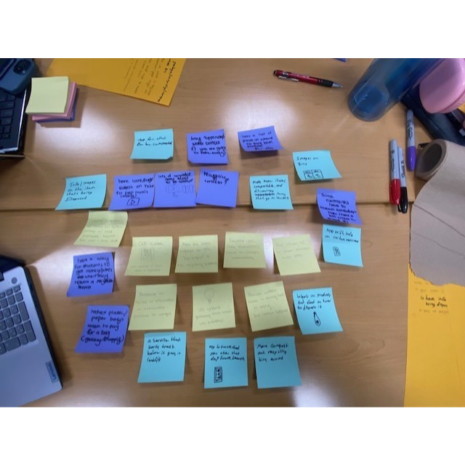
Brainstorming
Problem at hand: The lack of awareness, knowledge and effort regarding the environmental impacts of people's food choices
We narrowed it down to 3 ideas:
QR Code Database
Loyalty Program
Food Tracker
We thought the Food Tracker would be the most feasible option and do the best in addressing observed user needs
Notes:
Callum

Slide 6
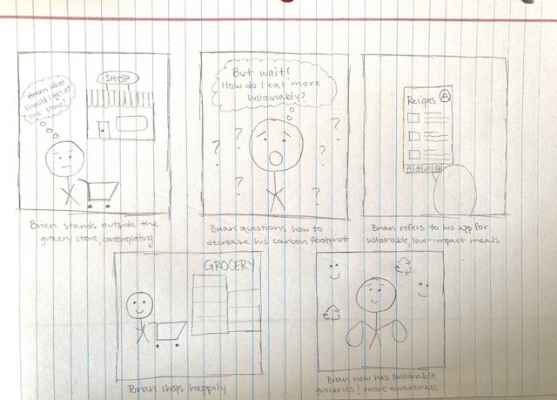
Storyboard
Notes:
Ann

Slide 7
Paper Prototype
Notes:
Ann

Slide 8
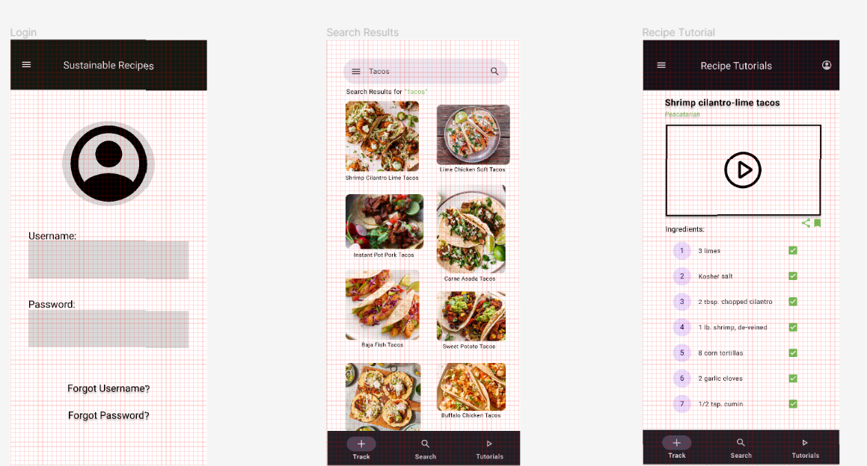
Wireframes
Notes:
Ann

Slide 9
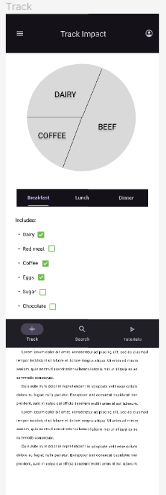
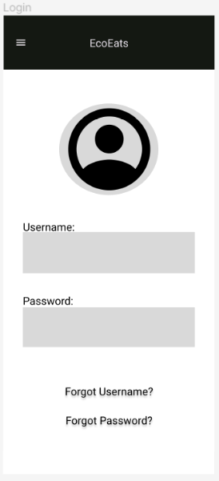
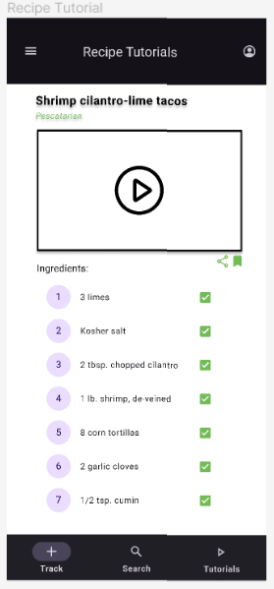
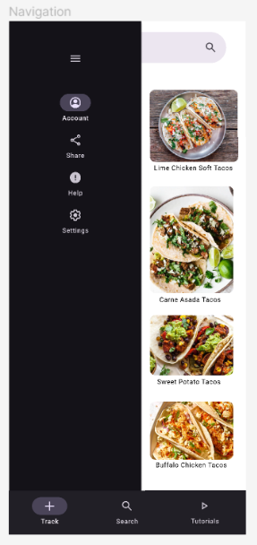
Final Design
Notes:
Corinne

Slide 10
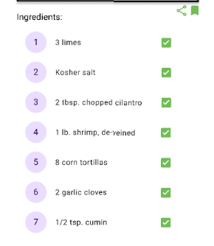
Mock-up
Added scroll to Track and Search pages
Allows for “Recommendations” section
Added a page to direct to from 3 horizontal lines
Green accents, consistency in color scheme
Drop shadow for emphasis, value
Check boxes for interactive element
Unity with top app bar, bottom navigation bar
Notes:
Corinne

Slide 11
With more time…
Have search results indicate how environmentally friendly they are/have a filter for search results to promote more sustainable recipes & boost user experience
More analysis/breakdown of foods to explain how & why they are either good or bad for the environment
Calculate users carbon footprint, compare it to what it needs to be to stay sustainable, show what they could to to reach that goal
Add more color
Notes:
Callum

Slide 12
Thank you!

